Slide 1
The Evolution of MoE (Mixture-of-Experts):
Insights from the DeepSeek Series Models
蔡觐阳

Slide 2
Content
Adaptive Mixtures of Local Experts (1991)
Outrageously Layer Neural Networks:The Sparsely-Gated Mixture-Of-Experts Layer (2017)
GShard: Scaling Giant Models with Conditional Computation and Automatic Sharding (2020)
Switch Transformers: Scaling to Trillion Parameter Models with Simple and Efficient Sparsity (2021)
DeepSeekMoE: Towards Ultimate Expert Specialization in Mixture-of-Experts Language Models (11 Jan 2024)
DeepSeek-V2: A Strong, Economical, and Efficient Mixture-of-Experts Language Model (7 May 2024 )
DeepSeek-V3 Technical Report (27 Dec 2024)

Slide 3
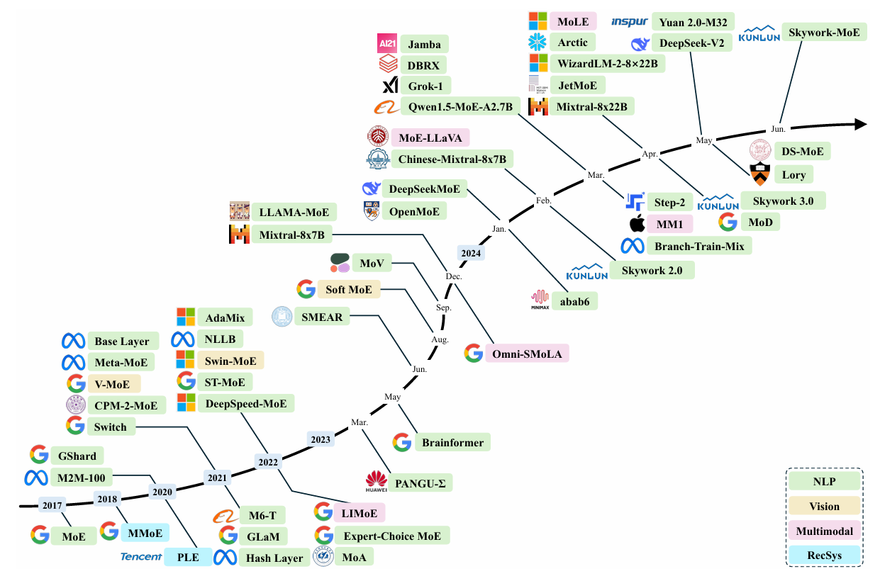
A Survey on Mixture of Experts

Slide 4
Adaptive Mixture of Local Experts
Interference Effects in Traditional Models
Slow Learning and Poor Generalization
Competition Among Experts

Slide 5
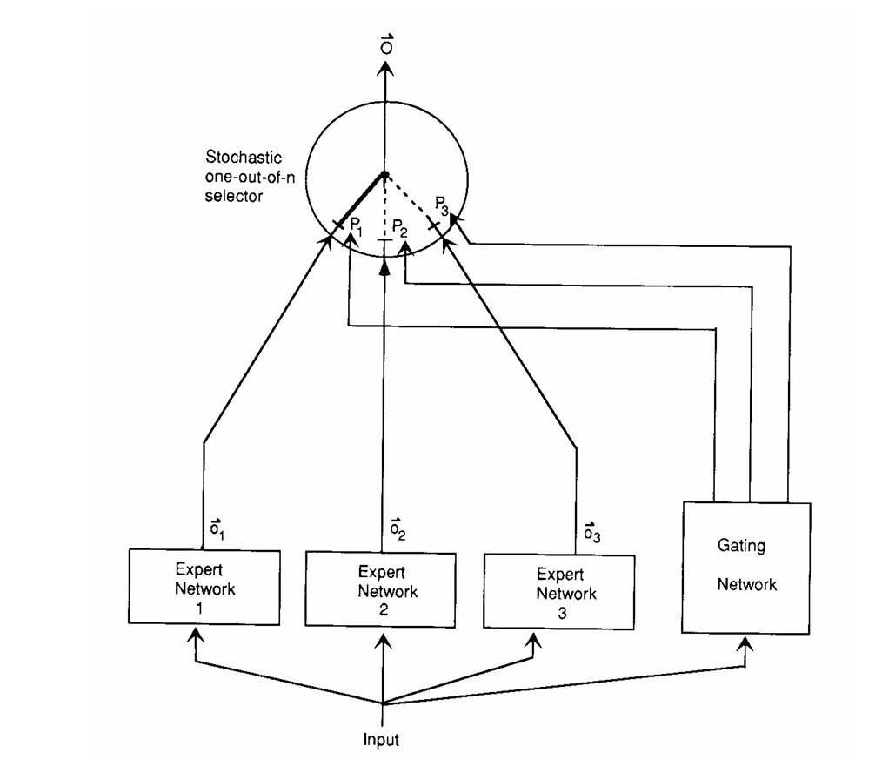
Adaptive Mixture of Local Experts
A system of expert and gating networks.
Each expert is a feedforward network and all experts receive the same input and have the same number of outputs.
The gating network is also feedforward and typically receives the same input as the expert networks.

Slide 6
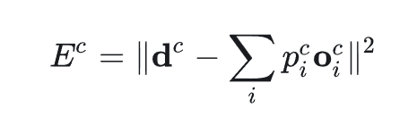
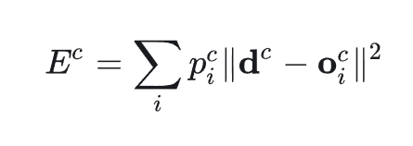
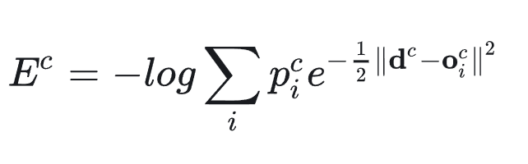
Adaptive Mixture of Local Experts
Experts Network: Modular Learning Approach
Gating Network: Making a Stochastic Decision About Which Expert to Use
Making Associative Learning Competitive
Encourage Competition Among Experts, Rather Than Cooperation
Loss Function Improvement

Slide 7
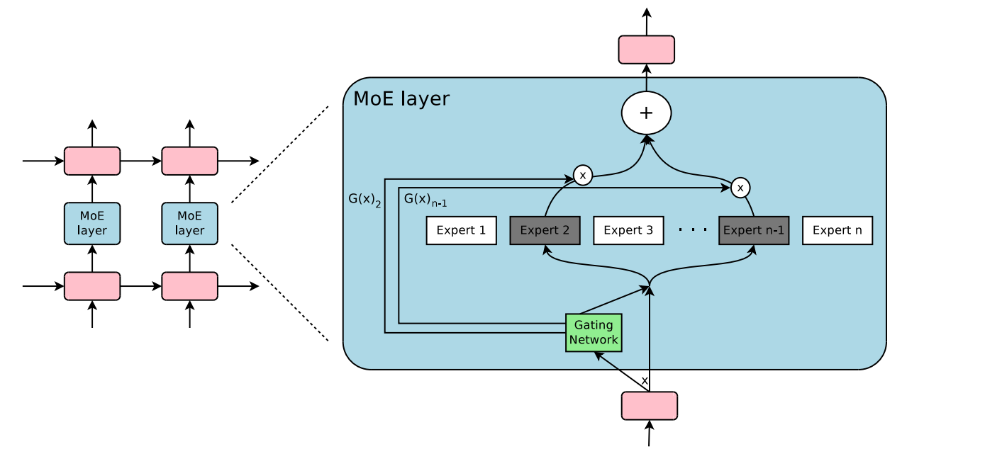
Outrageously Layer Neural Networks: The Sparsely-Gated Mixture-Of-Experts Layer
A Mixture of Experts (MoE) layer embedded within a recurrent language model.
In this case, the sparse gating function selects two experts to perform computations.
Their outputs are modulated by the outputs of the gating network.

Slide 8
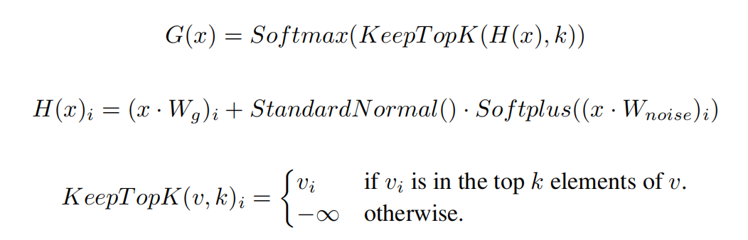

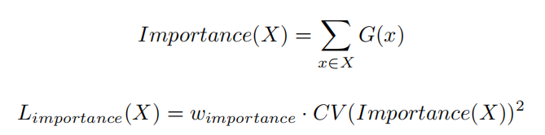
Sparsely-Gated Mixture-Of-Experts Layer
Mixture of Experts
the models are feed-forward networks with identical architectures, but with separate parameters.
Sparsely-Gated
Expert Utilization Balance
Additional Loss: Importance(X)

Slide 9
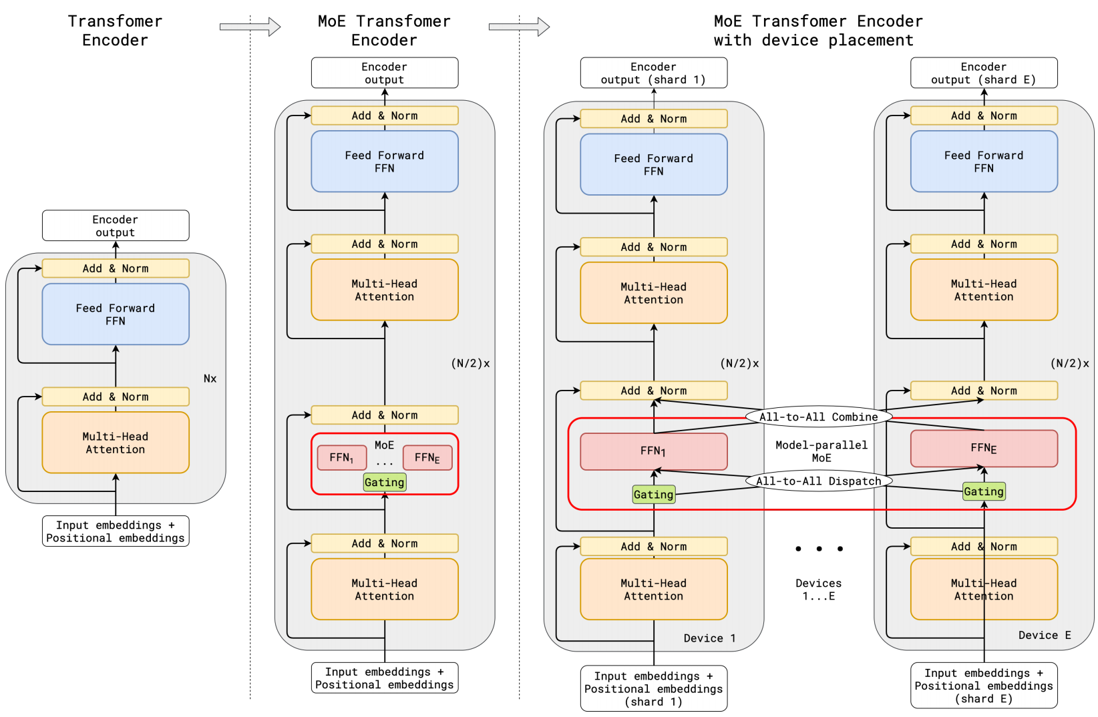
GShard: Giant Models with Automatic Sharding
The MoE layer replaces
the every other Transformer feed-forward layer.
(a) The encoder of a standard Transformer model is a stack of self-attention and feed forward layers interleaved with residual connections and layer normalization.
(b) By replacing every other feed forward layer with a MoE layer, we get the model structure of the MoE Transformer Encoder.
(c) When scaling to multiple devices, the MoE layer is sharded across devices, while all other layers are replicated.

Slide 10
GShard: Giant Models with Automatic Sharding
Sparse scaling of the Transformer architecture
The gating network computes a score for each expert and selects the top-k experts for each token.
Load Balancing and Expert Capacity Mechanism
Expert Capacity: Each token is dispatched to at most two experts.
Random Routing: The second expert is chosen randomly based on weight proportions, rather than always selecting the second-highest-scoring expert.
Auxiliary Loss: Encourages uniform token distribution across experts by minimizing the variance in the proportion of tokens processed by each expert, reducing redundancy.

Slide 11
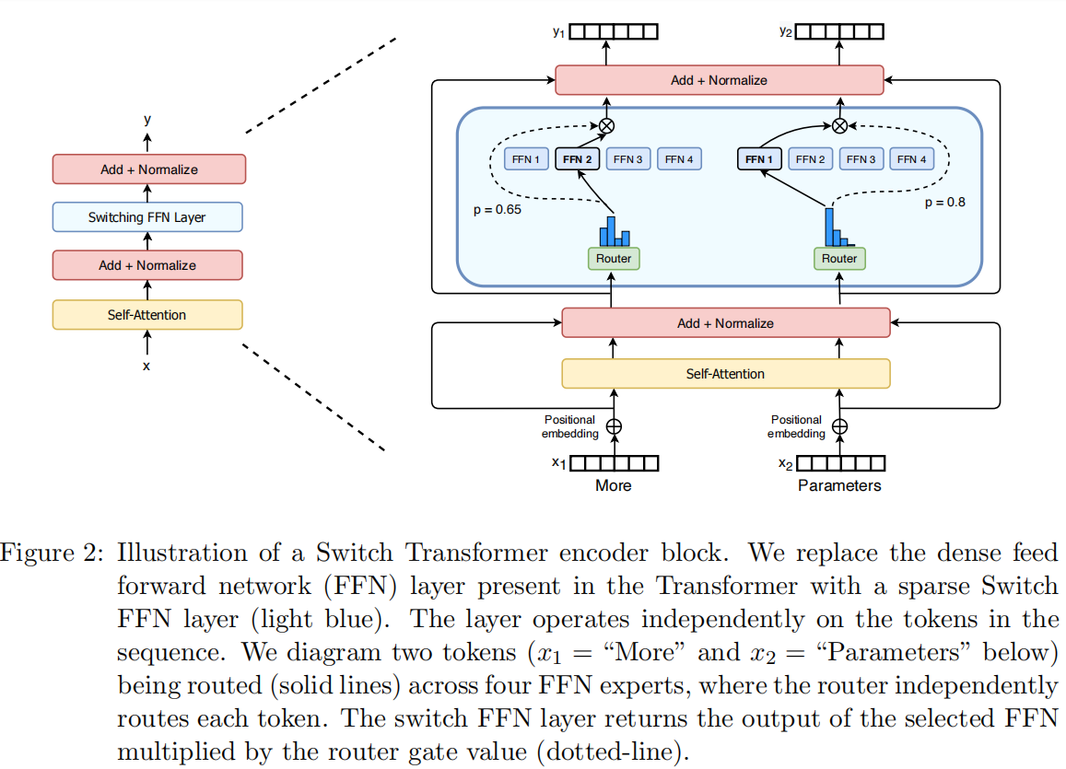
Switch Transformers

Slide 12
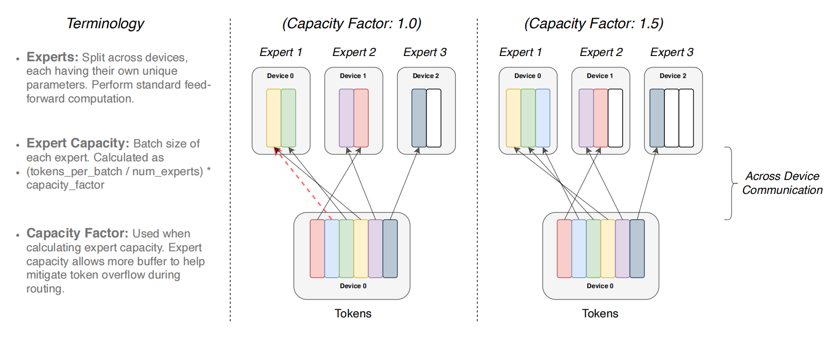
Switch Transformers
Simplifying Sparse Routing
Routing a Token to Only One Expert
Routing Implementation Is Simplified And Communication Costs Are Reduced

Slide 13
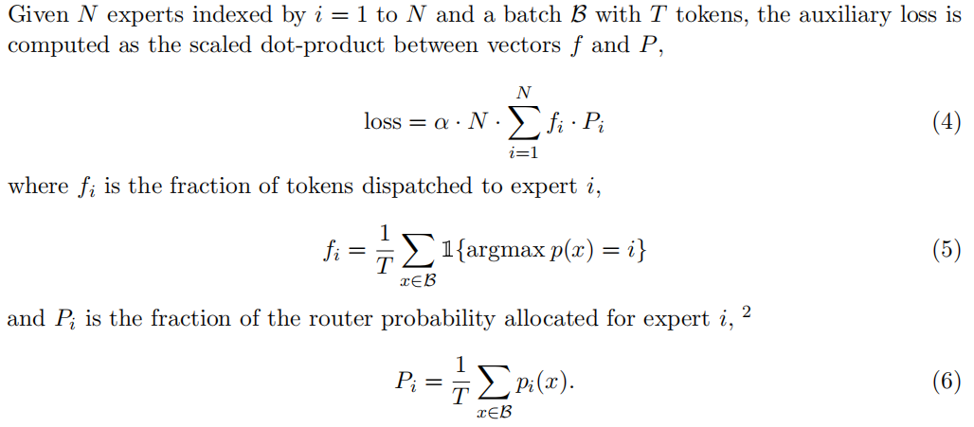
Switch Transformers
Efficient Sparse Routing
Load Balancing
Capacity Factor: Determines How Many Tokens Each Expert Can Handle
Auxiliary Loss Function: Encourages Uniform Routing Since It Is Minimized Under A Uniform Distribution
Expert Dropout: Increase The Dropout Inside The Experts

Slide 14
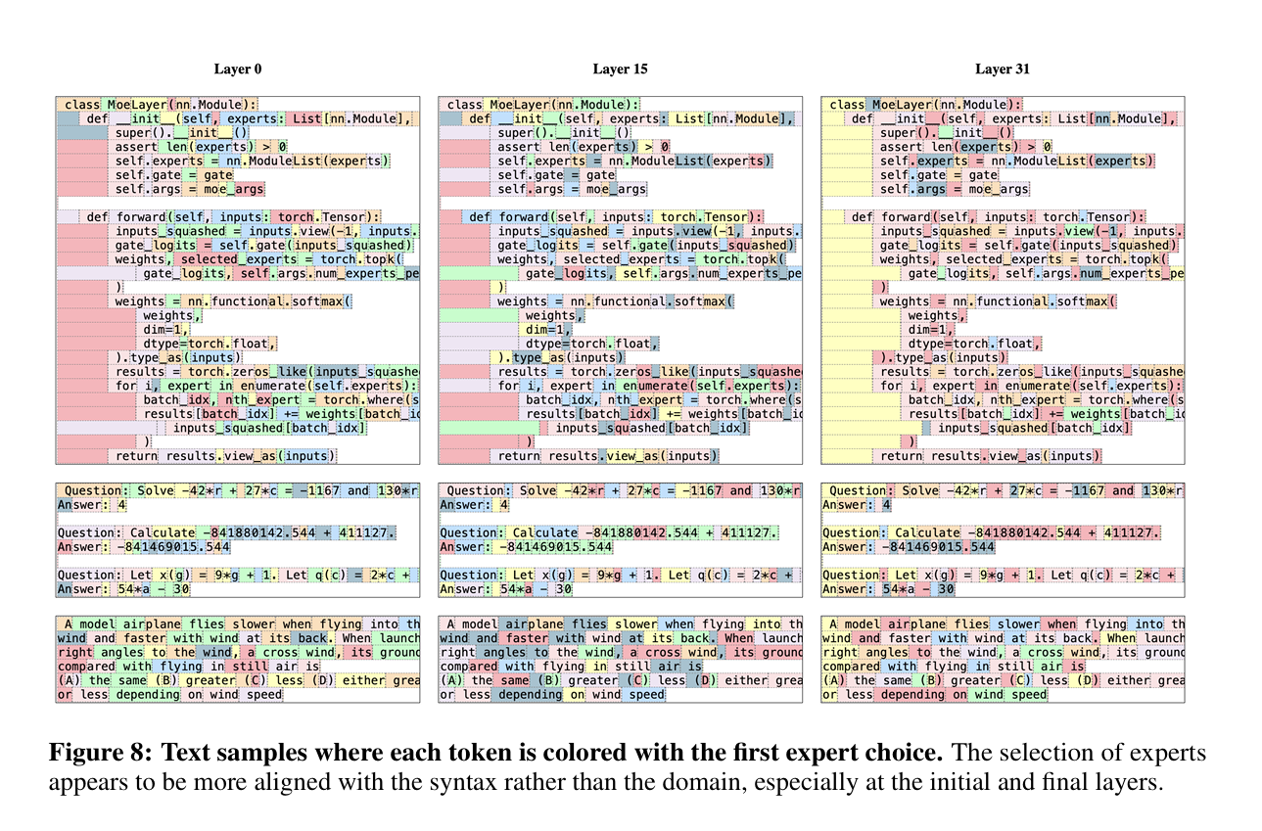
Mixtral of Experts

Slide 15
DeepSeekMoE: Ultimate Expert Specialization
Two Issues The Conventional MoE Architectures Suffer From
Knowledge Hybridity: Existing MoE practices often employ a limited number of experts. As a result, tokens assigned to a specific expert may cover diverse knowledge. Consequently, the designated expert will tend to assemble vastly different types of knowledge in its parameters, which are hard to utilize simultaneously.
Knowledge Redundancy: Tokens assigned to different experts may require common knowledge. As a result, multiple experts may converge in acquiring shared knowledge in their respective parameters, leading to redundancy in expert parameters.

Slide 16
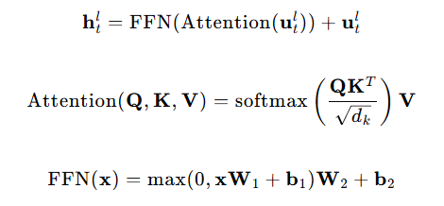
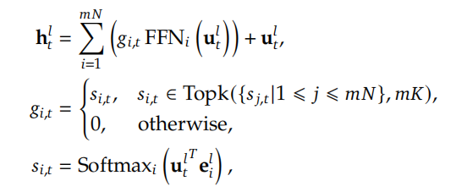
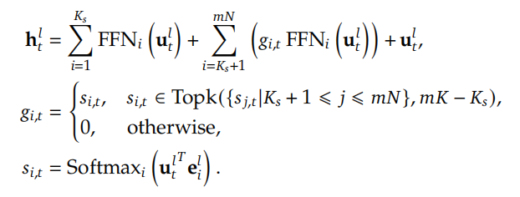
DeepSeekMoE: Ultimate Expert Specialization
Fine-Grained Expert Segmentation: Split experts into smaller groups and activate subsets dynamically
Shared Expert Isolation: Dedicate a subset of experts to handle universal knowledge, reducing redundancy among task-specific experts
Final Architecture

Slide 17
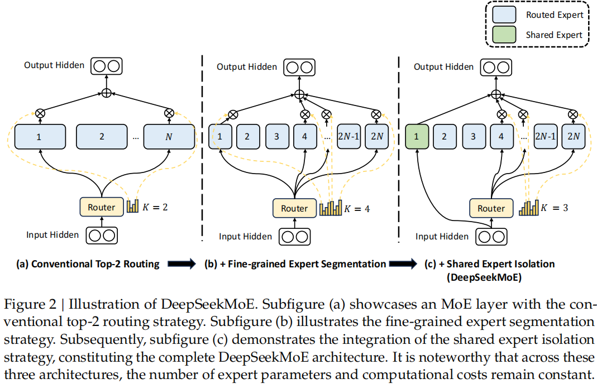
DeepSeekMoE: Ultimate Expert Specialization

Slide 18
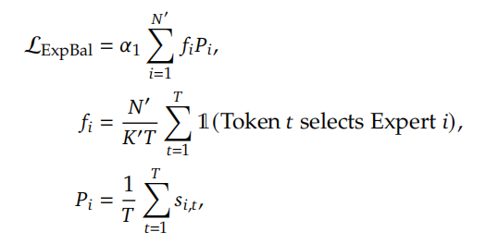
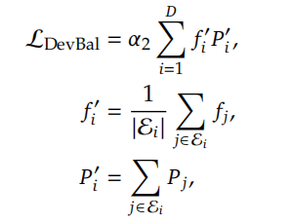
DeepSeekMoE: Ultimate Expert Specialization
Expert-Level Balancing: helps prevent routing collapse, where all tokens are routed to only a few experts, leading to inefficient use of model parameters
Device-Level Balancing: helps prevent computational bottlenecks where some devices are overloaded while others are underutilized

Slide 19
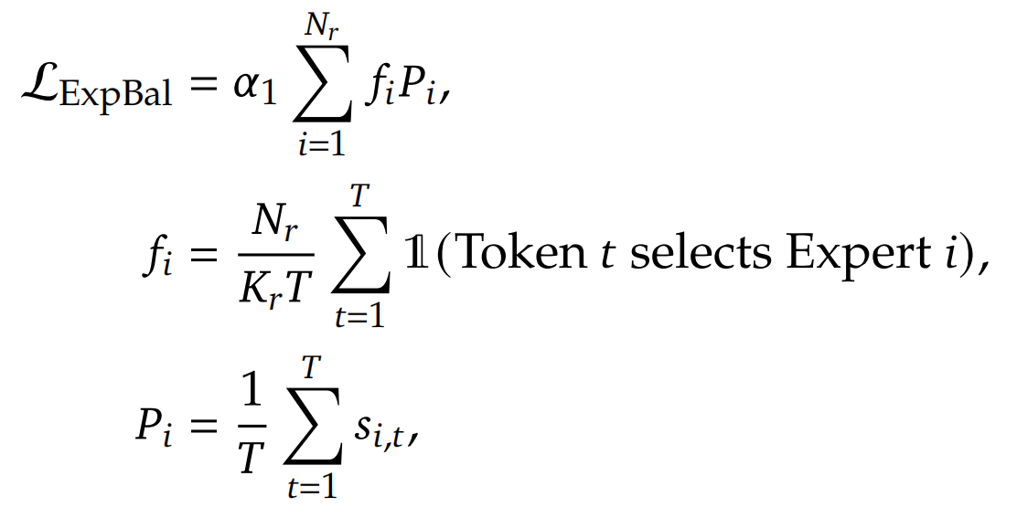
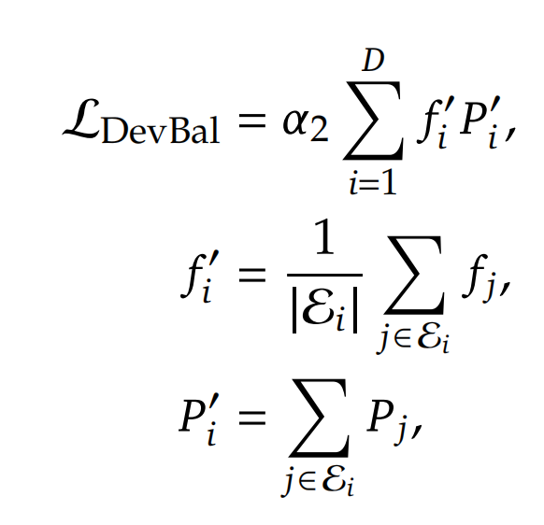
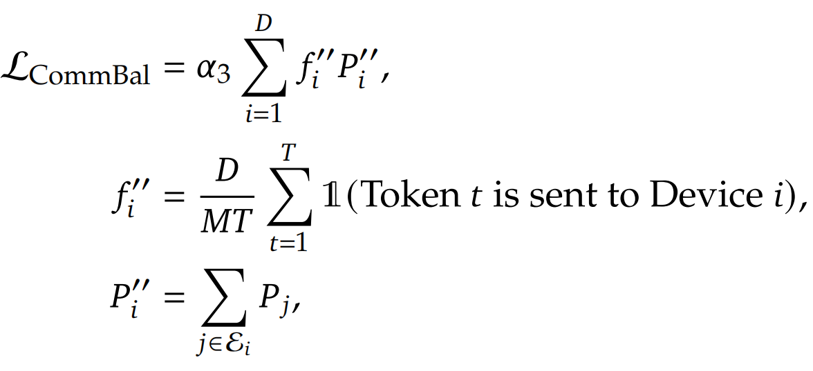
V2: Strong, Economical, and Efficient
Device-Limited Routing: beyond the naive top-K selection of routed experts, additionally ensure the target experts of each token will be distributed on at most 𝑀devices
Auxiliary Loss for Load Balance
Expert-Level Balance Loss Device-Level Balance Loss Communication Balance Loss
Token-Dropping Strategy: drop tokens with the lowest affinity scores on each device until reaching the computational budget, ensuring almost 10% will always be saved

Slide 20
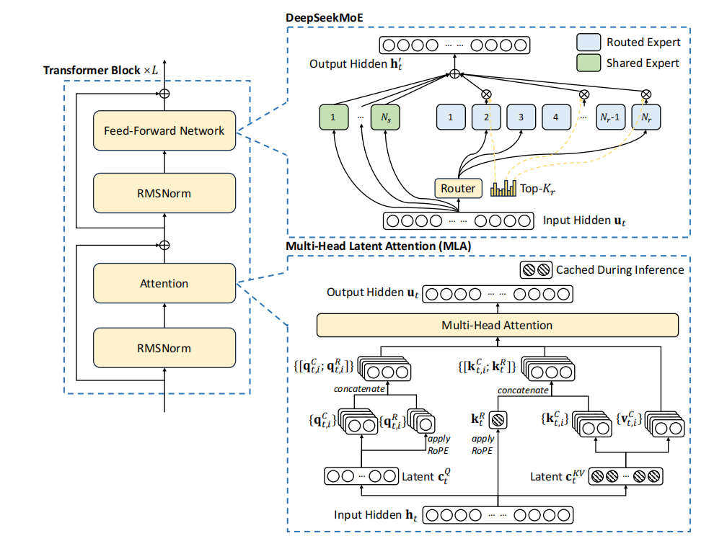
V2: Strong, Economical, and Efficient

Slide 21
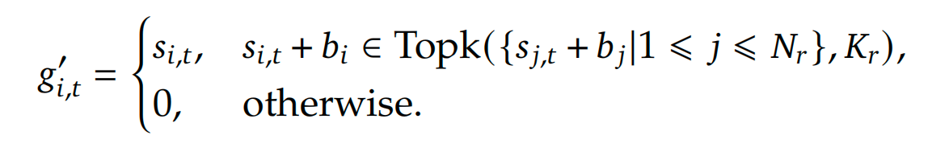
V3: Upgrade
Gating Network: uses the sigmoid function to compute the affinity scores, and applies a normalization among all selected affinity scores to produce the gating values
Auxiliary-Loss-Free Load Balancing
Node-Limited Routing
No Token-Dropping

Slide 22
References
R. A. Jacobs, M. I. Jordan, S. J. Nowlan and G. E. Hinton, "Adaptive Mixtures of Local Experts," in Neural Computation, vol. 3, no. 1, pp. 79-87, March 1991, doi: 10.1162/neco.1991.3.1.79.
Shazeer N, Mirhoseini A, Maziarz K, et al. Outrageously large neural networks: The sparsely-gated mixture-of-experts layer[J]. arXiv preprint arXiv:1701.06538, 2017.
Lepikhin D, Lee H J, Xu Y, et al. Gshard: Scaling giant models with conditional computation and automatic sharding[J]. arXiv preprint arXiv:2006.16668, 2020.
Fedus W, Zoph B, Shazeer N. Switch transformers: Scaling to trillion parameter models with simple and efficient sparsity[J]. Journal of Machine Learning Research, 2022, 23(120): 1-39.
Dai D, Deng C, Zhao C, et al. Deepseekmoe: Towards ultimate expert specialization in mixture-of-experts language models[J]. arXiv preprint arXiv:2401.06066, 2024.
Liu A, Feng B, Wang B, et al. Deepseek-v2: A strong, economical, and efficient mixture-of-experts language model[J]. arXiv preprint arXiv:2405.04434, 2024.
Liu A, Feng B, Xue B, et al. Deepseek-v3 technical report[J]. arXiv preprint arXiv:2412.19437, 2024.

Slide 23
References
Cai W, Jiang J, Wang F, et al. A survey on mixture of experts[J]. arXiv preprint arXiv:2407.06204, 2024.
Jiang A Q, Sablayrolles A, Roux A, et al. Mixtral of experts[J]. arXiv preprint arXiv:2401.04088, 2024.
https://zhuanlan.zhihu.com/p/423447025
https://zhuanlan.zhihu.com/p/542465517
https://zhuanlan.zhihu.com/p/672837901
https://zhuanlan.zhihu.com/p/672901722
https://zhuanlan.zhihu.com/p/20527211450
https://zhuanlan.zhihu.com/p/18565423596
https://zhuanlan.zhihu.com/p/21584562624

